Slide 1
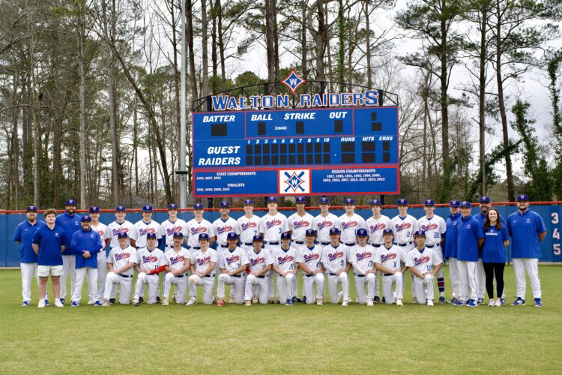
2
0
2
5

Slide 2
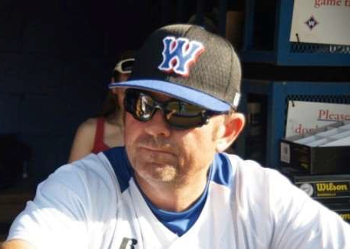
Varsity Coach
Head Coach, Shane Amos
Coach Amos starting his 39th season
37th season at Walton
493 Career Wins
Georgia Dugout Club Hall of Fame Inductee
Three GHSA State Championships

Slide 3
Baseball Staff
Varsity Coaching staff
Pierce Smith – Varsity Pitching Coach Parker Orr – Varsity Coach
Junior Varsity Coaching Staff
Austin Driskell – Head Coach
Mark Chillion - Assistant Head Coach

Slide 4
Varsity Schedule
30 games (18 region games/12 non-region)
First Scrimmage Feb. 6th at North Forsyth
First Game Feb. 11th at Walton
Games throughout winter & spring break
Dugout Club tournament:
Feb. 14th-15th at LakePoint

Slide 5
JV Schedule
21 games: 17 region, 2 non-region games & 2 “Postseason” games
1st game Feb. 11th at Harrison
Games during winter break

Slide 6
Important Dates
Raffle Tickets distributed: Sept. 17 (prospective players)
Homecoming Parade: Oct. 18 (current players only)
Raffle Tickets Due to Coach: Oct. 22
Day at the Yard: Oct. 27 (required of all trying out)
Tryouts: Jan. 27-30 (Jan. 31-Feb. 1 weather pending)
February Break: Feb. 17-21
[Games scheduled, so players DO NOT get week off]
Spring Break: April 7-11 (subject to change)
[Varsity return for practice–Tues, April 8, 5:00pm; JV will be off weather pending]
GHSA playoff dates: April 23-May 21

Slide 7
Walton Raider Dugout Club

Slide 8
WRDC BOARD
2024 - 2025
President: Jamie Dastou (12)
Vice President: Beth Schutz (10)
Treasurer: Michele Zerbenski (10)
Secretary: Amy Crowell (12)
Board Rep: Michelle Reuter (12)
Board Rep: Chris Lucas (11)
Board Rep: Kevin Killimett (11)
Board Rep: Ricky Tse (11)
Board Rep: TBD
Freshman-at-Large: TBD
Fundraising: Amy Hecklinski (11)

Slide 9
Mission Statement
The Walton Raider Dugout Club (WRDC) is a charitable, non-profit, fully recognized 501(c)(3) organization. The WRDC strives to make the most of the high school baseball experience for our players, coaches, and parents while maintaining a level of excellence that is consistent with the reputation of George Walton High School and the rich history of its baseball program.
The success of the WRDC hinges on parent involvement and community support. Since there is no Cobb County athletic funding, the WRDC’s fundraising efforts, volunteerism, and sponsorships are essential to provide the financial and organizational assistance needed to maintain a high quality baseball program. Furthermore, the WRDC recognizes the activities and achievements of its teams and players and makes every effort to promote those accomplishments in the community.

Slide 10
Budget Initiatives
Field Drag
Locker Room Flooring
Outfield Risers
Bleacher Shade
Nike Uniforms
Press Box Enhancement
PitchCom
Equipment, Gamechanger, etc.

Slide 11
Budget
Little funding from the county and school for athletics
On campus facilities require more from the budget
The Walton Raider Dugout Club (WRDC) fundraising is essential for Walton’s caliber of program
Baseball programs across the state conduct fundraising PRIOR to tryouts…
Not with ill intent, rather it is out of necessity given the baseball season timeline
The Board has implemented a NEW program after considering last year’s feedback

Slide 12
Fundraising Efforts
Sponsorships –
1st incentive: Sept. 11 - Oct. 25
2nd incentive: Oct. 26 - Feb. 10
Protected sponsorships thru Oct. 14
Commemorative Bricks – Feb. 7
Raffle – Oct. 22
Day at the Yard – Oct. 27
Baseball Clinic – Nov. 5
SnapRaise – Feb.
Online Auction - Oct. 27 - Feb. 7
Booster Club

Slide 13
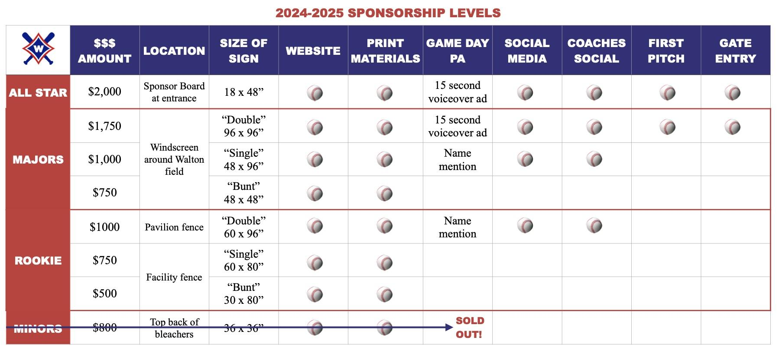
Sponsorships

Slide 14
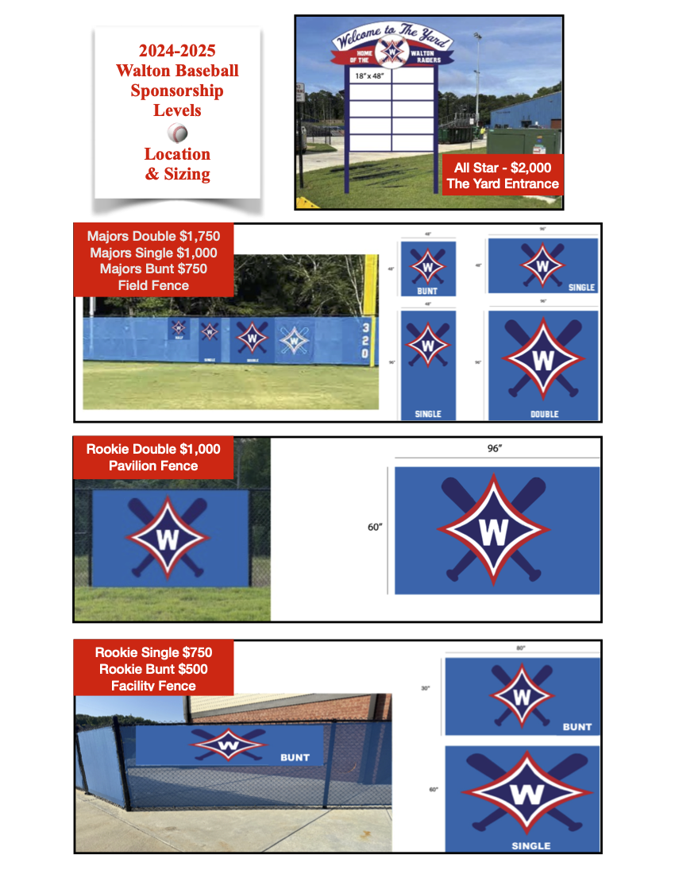

Slide 15
Sponsorships
Option 1: Pre-Tryout Incentive:
Deadline - Oct. 25
Credit - $100 Home Run Derby fee
Amount - $500 minimum
$1,000+ will receive $100 dues credit for every $500 above the initial $500; athlete must be rostered to a 2025 team for dues credit
Example - Matt secures $1,500 in sponsorships by October 25; Matt will receive $100 off the Home Run Derby and $200 off his 2025 player dues if he is rostered to a 2025 team.

Slide 16
Sponsorships
Option 2: In-Season Incentive:
Deadline - Oct. 26 - Feb. 10
Credit - $100 dues credit for every $500 in sponsorships
Amount - Donations of any amount are accepted
$500 is minimum for sponsorship benefits
Athlete must be rostered to a 2025 team for dues credit
Maximum dues credit is $1,000
Example - Joe secures $3,000 in sponsorships on Nov. 10; Joe will receive $600 off his 2025 player dues.

Slide 17
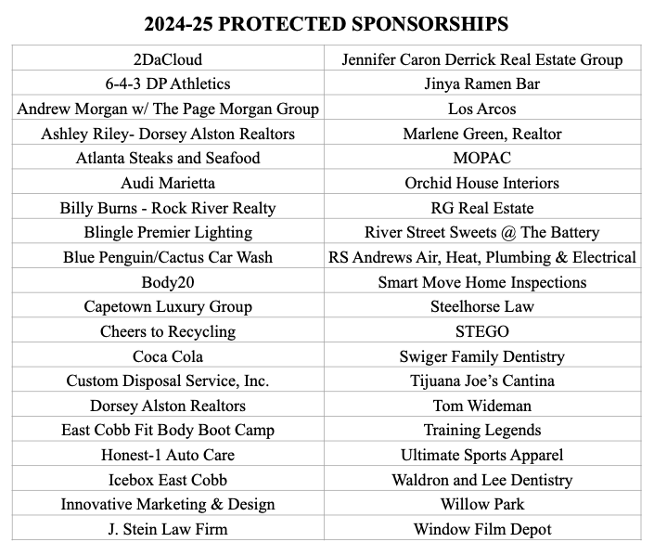
Sponsorships
Protected Sponsorships through Oct 14

Slide 19
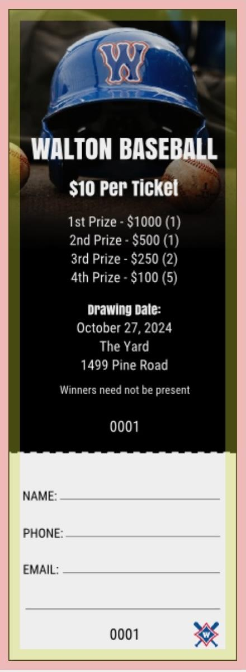
Raffle
Sept. 17 - Oct. 22
Sell 25
$10 per ticket
Cash prizes
Drawing = Oct. 27 - Day at the Yard Event

Slide 20
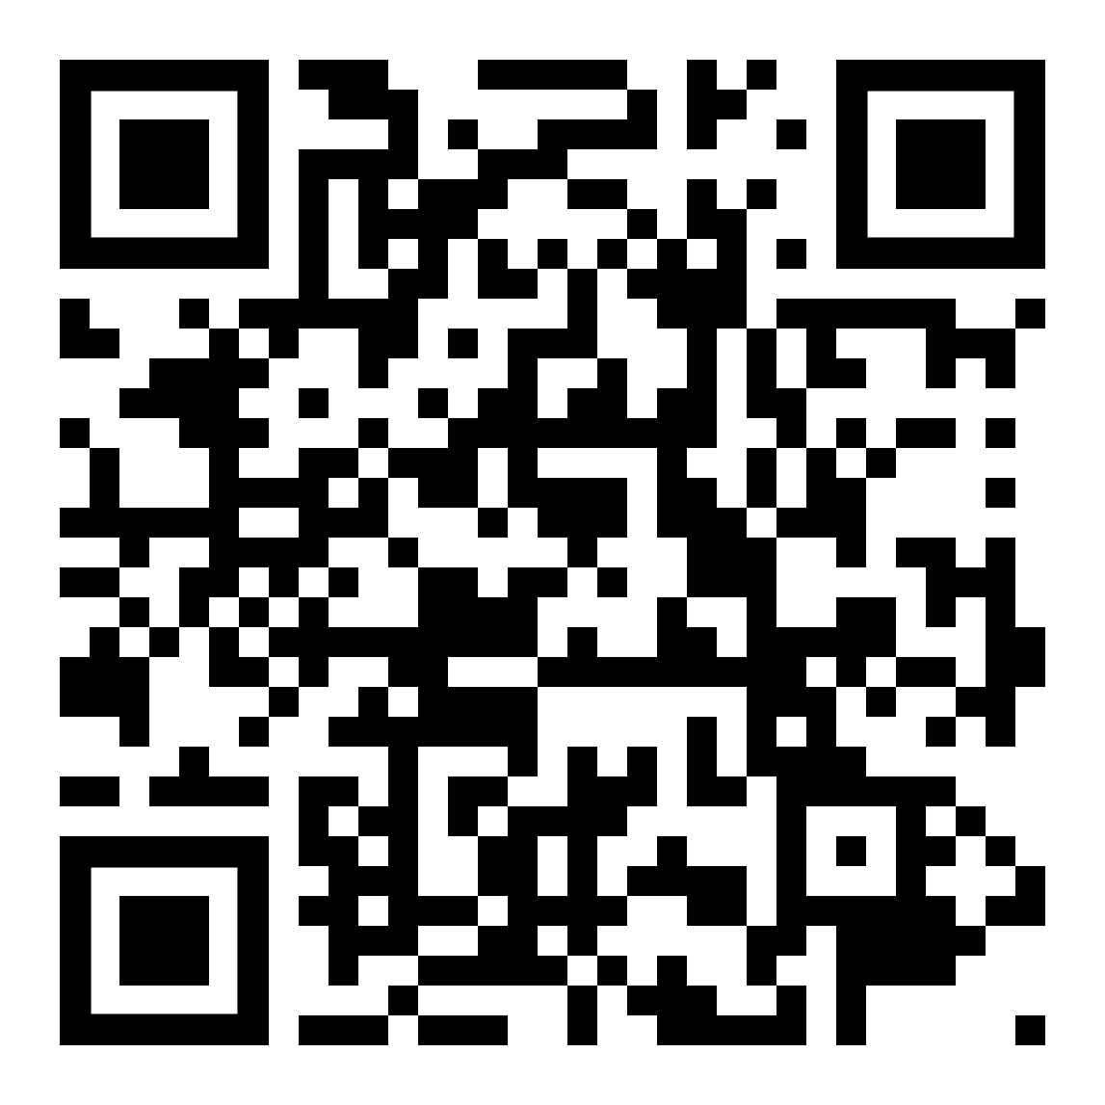
Day at the Yard
Oct. 27, 2:00pm-6:00pm
$100 entry for Home Run Derby
Mandatory for all prospective players
Register via Toolkit or QR code by 10/25

Slide 21
Youth Days

Slide 22
Online Auction

Slide 23
Player Incentive – Coach Orr
Goals – What are we trying to accomplish?
Looking to create a fun & competitive environment for Walton Baseball fundraising
Prizes
Individual Winner & Group Winners
Pictures posted on social media (IG & X “Twitter”: @Walton_Raiders)
Rankings/standings sent out to players weekly
Players throughout all grade levels will be grouped together & communicate with one another
Ideal Team: 1-2 Seniors, 2-3 Juniors, 3-4 Sophomores & 4-5 Freshmen
Underclassmen will be given a point of contact
Raise as much money as possible for Fieldhouse maintenance, Player Pack, new drag for field, other maintenance/upkeep to “The Yard”

Slide 24
Player Incentive – Coach Orr
Sponsorships
 | Rookie – Pavillion Banner | 5 points
 | Minors – Fence ACM | 5 points
 | Majors – “Bunt” Fence Banners | 8 points
 | Majors – “Single” Fence Banners | 10 points
 | Majors – “Double” Fence Banners | 18 points
 | All Star – Entrance | 20 points
Bricks
 | Standard Brick | 4 points
Donations
 | Every $100 donated | 1 point
Raffle Tickets
 | Every 10 Tickets sold | 1 point
Pictures/Selfie
 | Future Sponsor/Purchaser of brick/Volunteer Service/At Walton Sporting Event | 3 points (each)

Slide 25
Player Incentive – Coach Orr
Why is this important?
Growth of the Walton Raider Baseball Program in the community
The purchasing of:
Hack Attack maintenance, Pitchcom device
(V & JV), indoor netting, new uniforms purchases, etc.
Locker rooms cleaning/flooring
Social Media Software for edits/announcements
FREE GameChanger subscription
And so much more!
Builds accountability, teamwork & determination

Slide 26
Important Upcoming Player Dates - Coach Orr
Homecoming Parade on Oct. 18th
Returning Varsity/Junior Varsity players only
Must turn in permission forms to Coach Orr
Cobb Student Athlete’s Registration complete by 10/31 (through parentvue.com)
4-on-1s will run from Nov. 4th - Dec. 19th & Jan. 6th - Jan. 24th (4:00pm-6:00pm - 30 minute blocks)
C - Orr
INF/OF - Amos/Driskell
P - Smith/Chillion (Throwing Program/Bullpens for returners/Upperclassmen)
Morning Hitting starting Nov. 4th - Amos/Orr
The indoor will be open in the mornings from 7:00am - 7:50am (Exact days TBD & relayed to players)

Slide 27
Involvement/Volunteers
Ten board members
Need volunteers for all events
Fundraising – Day at the Yard, Sponsorships, Bricks
Social Events – First Pitch Banquet, Senior Night, End of Season Banquet, Teacher Appreciation
Game Day – Pre-game meals, concessions, field maintenance and post-game clean-up
Parade – Float Decoration
*Each family will be required to volunteer for various events via signup in Toolkit*

Slide 28
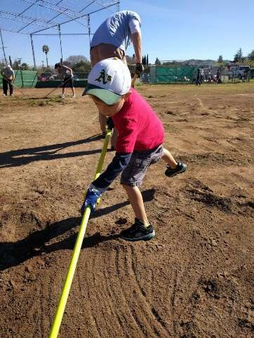
Winter Work Day
Nov. 16
Painting, debris removal, power washing, etc.
Sign-Up Genius list circulated
Varsity & JV players required*
[*Subject to change]

Slide 29
First Pitch Banquet
Monday, Feb. 3 @ 6:30pm - Cafeteria
Pay dues, join Booster Club/purchase merchandise, etc.
Discuss volunteer requirements via Toolkit
2025 Varsity & JV team introduction
Schedule for Varsity & JV season

Slide 30
Events
Teacher Appreciation
March 18th
Senior Night
April 2nd
Celebrate ℅ 2025
Introduce players & families after game
End-of-Season Banquet
Varsity & JV teams
TBD

Slide 31
Important Dates
Raffle Tickets Distributed: Sept. 17 (prospective players)
Homecoming Parade: Oct. 18 (current players only)
Raffle Tickets Due to Coach: Oct. 22 (prospective players)
Pre-Tryout Sponsorship Incentive: Oct. 25
Day at the Yard: Oct. 27 (more info to come)
Baseball Clinic: Nov. 5 (more info to come)
Tryouts: Jan. 27-29 (30 & 31 if weather)
Picture Day: Feb. 9, 2:00pm
February Break: Feb. 17-21
[Games scheduled, so players DO NOT get week off]
Spring Break: April 7-11
[Varsity return April 8, 5:00pm; JV off IF no make up games]
GHSA playoff dates: April 23-May 21

Slide 32
Player Dues
$1000 - $1500 per player for Varsity/JV
the exact dues amount will be determined in Jan. based on success of fall fundraising efforts
Sponsorship opportunities can offset some of your dues
Payment due at First Pitch Banquet (Feb. 3rd)
Dues are tax deductible for any business donation
Check if your business/employer provides corporate matching

Slide 33
Methods of communication
*Follow @walton_baseball on instagram & twitter*
Walton Baseball website:
https://waltonbaseball.org
Walton Dugout Questions:
wrdc@waltonbaseball.org
Walton Fundraising Questions:
fundraising@waltonbaseball.org
For Walton Baseball Questions:
Shane.Amos@cobbk12.org
Parker.Orr@cobbk12.org

Slide 34
Website:
Waltonbaseball.org

Slide 35
Thank You!

